Slide 1
Conditional/Repeat Statements
Topics
  if .. else
  For loop
  Do loop
  While loop

Slide 2
C code to Pseudo-C
C allows “goto” as means of transferring control
  Closer to machine-level programming style
Generally considered bad coding style
But, suitable for assembly programming
  More explicit control
  Directly mapped to assembly instructions

Slide 3
C constructs broken into pseudo-C with ‘goto’
Example – Add an array
sum = 0;
for (i=0; i<N; i++) sum += A[i];
printf(“Sum of array A is, %4d”,sum);
sum = 0;
i = 0;
Rept: if (i >= N) goto Done
sum += A[i];
i++;
goto Rept
Done: printf(“Sum of array A is, %4d”,sum);

Slide 4
Summary 1
if - else
if (!t) goto false;
then-statement;
goto done;
false:
else-statement;
done:
if (t)
then-statement;
else
else-statement;
while
while (Test)
Body
loop:
if (!Test) goto done;
Body
goto loop
done:

Slide 5
Summary 2
for loop
equivalent to:
for (Init; Test; Update )
Body
Init;
loop: if (!Test) goto done;
Body
Update ;
goto loop;
done:
Init;
while (Test ) {
Body
Update ;
}

Slide 6
General if-else translation
if (t)
then-statement;
else
else-statement;
int max(int x, int y){
if (x > y)
return x;
else
return y;
}
//t = test_expr;
if (!t) goto false;
do then-statement;
goto done;
false:
do else-statement;
done:
int goto_max(int x, int y){
int rval;
if (x <= y)goto else;
rval = x;
goto done
else:
rval = y;
done:
return rval;
}

Slide 7
Branch Instructions
b (unconditional)
Conditional
  beq, bne
  bge, bgt, ble, blt
  bgez, bgtz, blez, bltz
Set Condition
  sltz

Slide 8
Conditional Branch Example
int goto_max(int x, int y){
int rval;
if (x <= y) goto else;
rval = x;
return rval;
else:
rval = y;
return rval;
}
# x in $a0, y in $a1
# return value in $t0
max:
ble $a0, $a1, else
move $t0, $a0
#or $t0, $a0, $0
jr $ra
else:
or $t0, $a1, $0
jr $ra

Slide 9
Better “While” Translation
while Translation
Goto Version
C Code
while (Test)
Body
if (!Test) goto done;
loop:
Body
if (Test) goto loop
done:
Better Translation
Goto Version
C Code
while (Test)
Body
loop:
if (!Test) goto done;
Body
goto loop
done:

Slide 10
“While” Example
C Code
Alternative Goto Version
int fact_while(int x){
int result = 1;
while (x > 1) {
result *= x;
x = x-1;
};
return result;
}
int fact_while_goto(int x){
int result = 1;
loop:
if (!(x > 1)) goto done;
result *= x;
x = x-1;
goto loop;
done:
return result;
}

Slide 11
“For”→ “While”
For Version
While Version
for (Init; Test; Update )
Body
Init;
while (Test ) {
Body
Update ;
}
Init;
loop: if (!Test) goto done;
Body
Update ;
goto loop;
done:

Slide 12
for (Init; Test; Update )
Body
Init;
loop: if (!Test) goto done;
Body
Update ;
goto loop;
done:
int result;
for (result = 1;
p != 0;
p = p>>1) {
if (p & 0x1)
result *= x;
x = x*x;
}
result = 1;
loop: if (p == 0) goto done;
if (p & 0x1)
result *= x;
x = x*x;
p = p >> 1;
goto loop;
done:

Slide 13
General “Do” Translation
C Code
Pseudo Code
do
Body
while (Test);
loop:
Body
if (Test)
goto loop
  Body can be any C statement
    Typically compound statement:
  Test is expression returning integer
    = 0 interpreted as false
    ≠ 0 interpreted as true
{
Statement₁;
Statement₂;
…
Statement_{n};
}

Slide 14
“Do” Loop Example
do
Body
while (Test);
loop:
Body
if (Test)
goto loop
C Code
Goto Version
int fact_do(int x)
{
int result = 1;
do {
result *= x;
x = x-1;
} while (x > 1);
return result;
}
int fact_goto(int x)
{
int result = 1;
loop:
result *= x;
x = x-1;
if (x > 1)
goto loop;
return result;
}
  Use backward branch to continue looping
  Only take branch when “while” condition holds

Slide 15
“Do” Loop Compilation
Goto Version
Assembly
int fact_goto
(int x)
{
int result = 1;
loop:
result *= x;
x = x-1;
if (x > 1)
goto loop;
return result;
}
# x in $a0, result in $t0
fact_goto:
li $t0, 1
li $t1, 1
loop:
mul $t0, $t0, $a0
addi $a0, $a0, -1
ble $a0, $t1, loop
jr $ra

Slide 16
sum = 0;
i = 0;
Rept: sum += A[i];
i++;
if (i < N) goto Rept
printf(“Sum of array A is, %4d”,sum);
.data
A: .word 5:20 # 20-element array of initial values of 5
.text
main: li $t0, 0 # $t0 <- sum
li $a0, 0 # $a0 <- array index
li $t9, 80 # array index upper bound in C context
rept:
lw $t2, A($a0) # $t2 <- value in the array
add $t0, $t0, $t2 # sum += A[i]
addi $a0, $a0, 4 # i++ in bytes
blt $a0, $t9, rept
….

Slide 17
“For” Loop Example
x**p
Algorithm
  A binary representation: p = p₀ + 2p₁ + 4p₂ + … 2^{n–1}p_{n–1} (p_{i} = 0, 1)
  Gives: x^{p} = z₀ · z₁ ² · (z₂ ²) ² · … · (…((z_{n –1}²) ² )…) ²
    z_{i} = 1 when p_{i} = 0
    z_{i} = x when p_{i} = 1
  Complexity O(log p)
n–1 times
Example
3¹⁰ = 3² * 3⁸
= 3² * ((3²) ²) ²

Slide 18
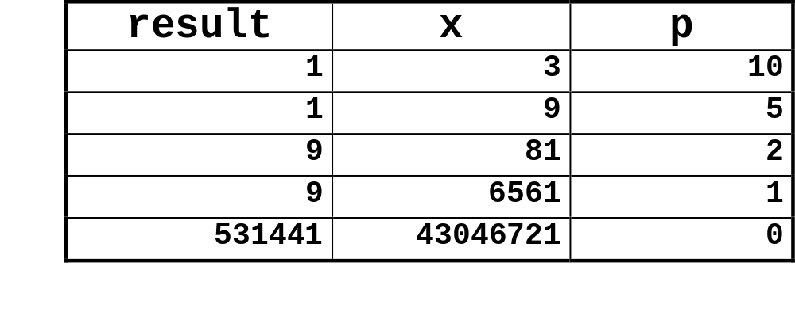
ipwr Computation
/* Compute x raised to nonnegative power p */
int ipwr_for(int x, unsigned p) {
int result;
for (result = 1; p != 0; p = p>>1) {
if (p & 0x1)
result *= x;
x = x*x;
}
return result;
}

